Slide 1
Lecture 22
Delta I_{DDQ} Testing and Built-In Current Testing
Current limit setting
Testing time issues
Delta I_{DDQ} testing (Δ I_{DDQ})
Built-in current testing sensors
Summary

Slide 2
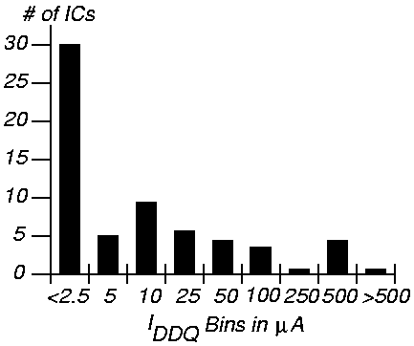
Current Limit Setting
Should try to get it < 1 μA
Histogram for 32 bit microprocessor

Slide 3
Hewlett-Packard / Sandia Laboratories Results
HP – static CMOS standard cell, 8577 gates, 436 FF
Sandia Laboratories – 5000 static RAM tests
Reject rate for various tests:
Com-
pany
HP
San-
dia
Scan and Functional Tests
Reject Rates
(%)
Without I_{DDQ}
With I_{DDQ}
Without I_{DDQ}
With I_{DDQ}
Neither
16.46
0.80
No Scan/
Funct.
6.36
0.09
Scan/
No Funct.
6.04
0.11
Both
5.80
0.00
Functional Tests
5.562
0

Slide 4
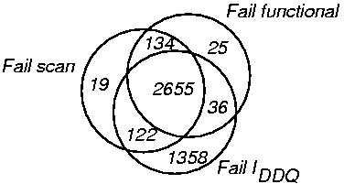
Failure Distribution in Hewlett-Packard Chip

Slide 5
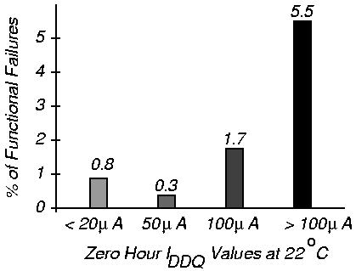
% Functional Failures After 100 Hours Life Test
Work of McEuen at Ford Microelectronics

Slide 6
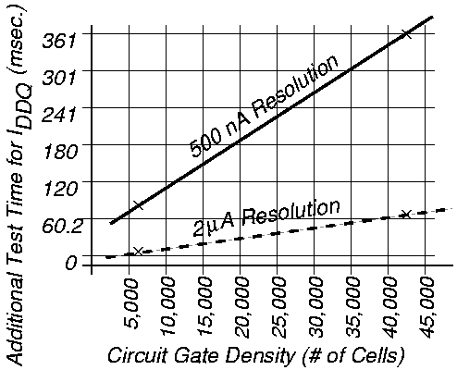
Lower / Upper I_{DDQ} Test Time Limits – McEuen (Ford)

Slide 7
Delta I_{DDQ} Testing -- Thibeault
Use derivative of I_{DDQ} at test vector as current signature
Δ I_{DDQ} (i) = I_{DDQ} (i) – I_{DDQ} (i – 1)
Leads to a narrower histogram
Eliminates variation between chips and between wafers
P – probability of false test decisions

Slide 8
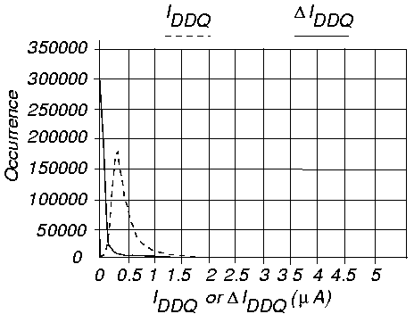
I_{DDQ} Versus ΔI_{DDQ}

Slide 9
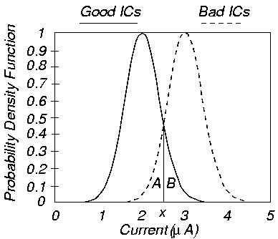
Difference in Histograms
A – test escapes, B – yield loss

Slide 10
Parameters for Estimating P
Δ_{def} -- minimum | ΔI_{DDQ} | peak from active defect, μ_{g} = good mean, μ_{b} = bad mean
Dist.
Param
P
μ_{g}
Δ_{def}
μ_{b}
σ²
I_{DDQ} ΔI_{DDQ}
Symbol
P_{iddq}
μ_{gi}
Δ_{def}
μ_{gi} + Δ_{def}
σ_{i}²
Δdef
0.3
0.4
0.5
Value
Below
0.696
0.4
1.096
0.039
P_{iddq}
0.059
0.032
0.017
Symbol
P_{delta}
μ_{gd} ( 0)
Δ_{def}
μ_{gd} + Δ_{def}
σ_{d}²
P_{delta}
7.3e⁻⁴
4.4e⁻⁵
1.7e⁻⁶
Value
Below
-2e⁻⁴
0.4
0.4
0.004
P_{iddq} / P_{delta}
81
721
10000
Values of P for different Δdef Values

Slide 11
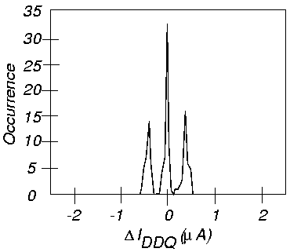
Example Differential I_{DDQ} Histogram
Better peak
  resolution
  with
  | Δ I_{DDQ} (i) |,
  doubles
  point
  count

Slide 12
ΔI_{DDQ} Testing Results
Item
R_{YL} (yield loss ratio)
R_{TE} (test escape ratio)
P (= R_{YL} + R_{TE})
Gain in test quality
I_{DDQ}
4.4e⁻⁴
1.8e⁻¹
P_{iddq} = 1.8e⁻¹
ΔI_{DDQ}
3.5e⁻³
2.1e⁻³
P_{delta} = 5.6e⁻³
P_{iddq} / P_{delta} = 31

Slide 13
I_{DDQ} Built-in Current Testing – Maly and Nigh
Build current sensor into ground bus of device-under-test
Voltage drop device & comparator
  Compares virtual ground V_{GND} with V_{ref} at end of each clock – V_{GND} > V_{ref} only in bad circuits
  Activates circuit breaker when bad device found

Slide 14
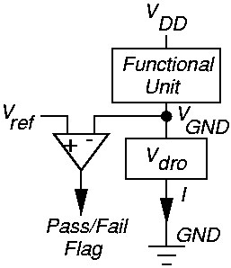
Conceptual BIC Sensor

Slide 15
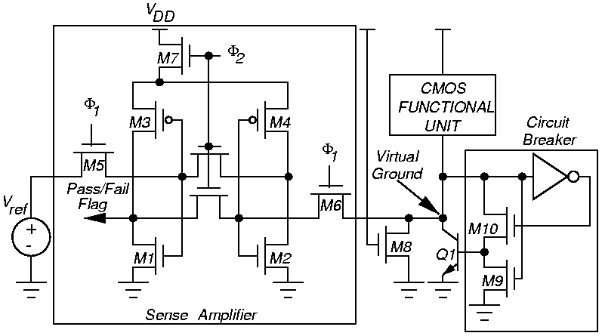
CMOS BIC Sensor

Slide 16
Setting Optimal # Transistors in Block
Must partition chip into functional units, each with its own BIC
  Too large a unit – combined leakage currents erroneously trigger BIC sensor
I_{defmin} – smallest defect current
I_{noisemax} – maximum noise-related peak supply current
Minimum area sensor design at I_{defmin} and I_{DDQ} intersection
N_{max} – maximum # transistors in 1 BIC unit

Slide 17
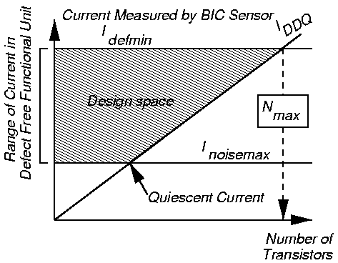
Graph for Choosing N_{max}

Slide 18
Summary
I_{DDQ} current limit setting to differentiate between good and bad circuits is difficult
I_{DDQ} testing is becoming more problematic
  Greater leakage currents in MOSFETs in deep sub-micron technologies
  Harder to discriminate elevated I_{DDQ} from 100,000 transistor leakage currents
ΔI_{DDQ} holds promise to alleviate problems
Built-in current testing holds promise

